Slide 2

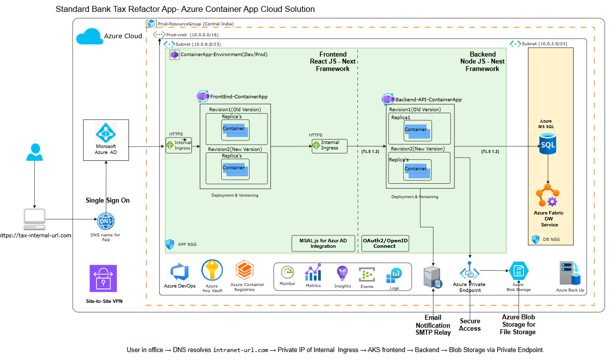
Cloude Architecture View-VM in Azure, Fabric DW, SharePoint

Slide 3
Cloude Architecture View-VM in Azure, Fabric DW, SharePoint

Slide 4
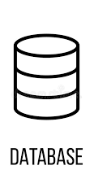












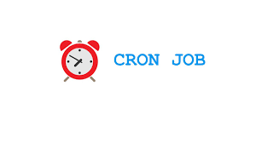


Proposed Architecture
1
Presentation Layer
2
API Gateway
3
Backend Microservices
5
Backend Down Stream Systems
Design System
REST / GRAPHQL / GRPC - API
Application Building blocks
AI Model Microservice
User Access /Role Management
External API
Routing
Library
API
Gateway
Search Functionality API
User Views
End User
Information(Profile)
Notification Services
Component
HTTPS Call to API
HTTPS
Insurance Verification Microservice
Wrappers/ Helper/ Utilities
User Access and Role Management
Authentication / Authorization
Services
CONNECTOR
4
Amazon Bedrock (Generative AI/GPT)
Utilities
Modules
Bulk Upload
WEB
Parser for Feed File Generation
Login Functionality
Modules(n)
Identity
Provider
Web App
Search Functionality
Reporting and Data Export
Text
Generation
Chatbots
Image
Generation
Archive
Purge
Information (profile) Display
User Specific Views
Search
Text
Summarization
Personalization
GPT- Chatbot
SUPPORTING
PLATFORM
Microfrontend Composed Application(s)
Gateway
AA IT OPS
MONITORING & NOTIFICATION
SECURITY & ACCESS CONTROL
Above proposed Architecture diagram will be refined post Solution Engineering Phase
Middleware Service Layer

Slide 5
VendorPulse Solution Architecture (Shell)
Single-tenant in Shell Azure. Deterministic core first, AI second. Agent layer: MAF SDK on Microsoft Foundry.
1
3
5
Client
Edge
Shell Azure Subscription
External
icon
icon
West Europe / Private VNet
Outbound HTTPS
Web client (browser)
icon
Azure App Service (Linux container) - FastAPI app
Microsoft Entra ID
Shell SSO, groups to roles, app identity
icon
outbound HTTPS
VMO Coordinator / Sponsor / Viewer
authenticated via Entra SSO
Entra OIDC auth + RBAC
WorkflowEngine (12-state)
2
Azure Front Door + WAF
TLS, OWASP, origin-lock
Approval gate
MAF Agent layer to Foundry
React 19 SPA
Design System / ApprovalPanel
Microsoft Foundry
Responses API + content safety
Deterministic services
GraphService (app-only cert)
icon
4
Native scorecard form
magic-link, Entra SSO (ADR-005)
Data Tier - Managed Identity, Private Link (no public access)
Azure PostgreSQL
Flexible Server
Azure Key Vault
LLM key / Graph cert / JWT
Blob Storage
minutes, transcripts
App Insights + Log Analytics
OTel / immutable audit
Microsoft Graph (Shell tenant)
Mail.Send / Calendars / OnlineMtgs
icon
AI-generated, pending approval
transparency badge (IRM 3.5.3)
cycles / scorecards / meetings / agent_runs
1 Client / SSO sign-in 2 Front Door + WAF 3 App Service: workflow + approval gate 4 Data tier via Private Link 5 External services over outbound HTTPS

Slide 6
VendorPulse Deployment Architecture (Shell Azure)
[ PRODUCT LOGO ]
Single-tenant. West Europe. Azure App Service. Private VNet. App-only certificate auth.
Access path
Shell user
on corporate network
icon
Shell Azure Subscription - West Europe
External (outbound HTTPS)
1
icon
2
5
Azure Front Door + WAF - TLS 1.2+, OWASP, origin-locked to App Service
Microsoft Foundry
Responses API + content safety
icon
3
via egress proxy
Microsoft Entra ID
Shell SSO
icon
Private VNet (VNet integration, Private Endpoints)
Azure App Service (Linux container)
4
Data Resource Group
Microsoft Graph (Shell)
Mail / Calendar / Teams (app-only cert)
icon
Production slot (TLS 1.2+)
Postgres
Flexible
Key Vault
cert, keys (PE)
Single Sign-On
OIDC / MSAL
SPA (React / nginx)
Private Link
FastAPI + MAF agents
Blob Storage
minutes (PE)
Entra ID (app reg)
VendorPulse-Prod, cert in KV
vendorpulse.it.shell.com
DNS to Front Door
Staging slot
blue-green / zero-downtime swap
Private Link
Shell egress proxy
outbound control
DevOps & Observability
GitHub Actions / Azure DevOps
Container Registry (ACR)
Azure Monitor
Application Insights
Log Analytics / immutable audit
Shell user to DNS (vendorpulse.it.shell.com) to Front Door (WAF) to App Service (private) to PostgreSQL via Private Link. Graph and Foundry via outbound HTTPS (egress proxy). Managed Identity to Key Vault / DB, app-only certificate to Graph.

